Slide 1
ClassPortal All Your Online Learning Essentials at One Place
Presented By SUST__NOOBs

Slide 2






Project Purpose
Boring
Student gets bored during video conference classes
Lockdown
Whole education system is closed during lockdown
Problem
As all educational institutions has been closed because of pandemic, students are deprived of both theoretical and practical education. Which makes students fully incapable to get hands-on laboratory activities. Though theoretical courses are being taken through video lectures still there are communication gap between teacher and students.
Communication Gap
Teacher and student aren’t able to communicate properly
No Practical Education
Teachers aren’t able to take online practical classes.

Slide 3
Our Solution
Our website provides a platform where the communication gap is minimized between teachers and students.
Hands-on activities are handled through 3D simulations where students can gain lab-based knowledge.

Slide 4
Features
- Since our solution is a website, it requires only a web browser to access.
- Using 3d simulations rather than 2d give us a better understanding of the whole laboratory experiment. Also, while using vr will give even better experience, it is too expensive for most users.
- Teachers do not need to know how to make 3D models as it will be maintained by the system admin.
- Teachers can customize their rooms with any number of sections as they need.

Slide 5





Whitelisted
The frontend URLs are whitelisted to prevent CSRF attack
Authentication
Role based user authentication is used to limit user data access.
Sanitization
All of the data taken from the user is sanitized before storing in the database to defend the system from XSS Attack.
Robustness,
behavior of system under non-standard conditions
Django Default
Input validation or sanitization is handled by Django framework to prevent SQL injection or DDOS attack.
HTTP-Only Cookie
The authorization token is stored in the HTTP-only cookie in the browser of the user to make it more secure.

Slide 6




Security
JWT Based Authentication
Email verification
Role Based Permission
Hashed Password

Slide 7
Feasibility Study
Operational Feasibility
Teachnical Feasibility
- Since we conduct the lab part in a virtual environment, we don’t have any limitations for how many users can access the same lab at the same time as long as the servers aren’t overloaded. Also, our website ensures equal accessibility for everyone as we don’t provide multiple versions of the laboratory simulations(e.g. AR, VR).
- If any new simulations are needed, the respective teachers can just contact the admin. Then our design and development team will create the needed 3d models and develop the simulation. The admin will then update the laboratory catalogue accordingly.
- Just with some minor changes we can make our website available for any kind of educational institutions.
- Almost all laboratory simulations can be easily created using the existing technology. We can create any 3d models using blender and for creating the simulations we can use unity game engine.

Slide 8
Business Strategies
Low Cost for Users
Users don’t need to buy any additional devices (e.g. AR/VR equipment) except smartphone\computer
Zero Lab Maintenance Cost
As we don’t need any laboratory tools for the lab simulations, we don’t have any extra cost for lab maintenance
Centralized
Users don’t need to maintain multiple accounts in different apps/websites to communicate. All theory and practical resources provided by teachers can be accessed from our website.

Slide 9
Future Plan
- We will further expand our website to support other educational institutions like schools, colleges.
- We will create a separate admin panel for maintaining multiple institutions, their user related operations and uploading 3d simulations.
- We will add support for exams, file upload and other features.

Slide 10
Tech Stack
Backend
- Django
- Django Rest Framework
Database
- PostgreSQL
Simulation
- Unity 3D Game Engine
Frontend
- ReactJs

Slide 11
Others
Collaboration and Version Control
- GitHub
API Testing
- Postman

Slide 12
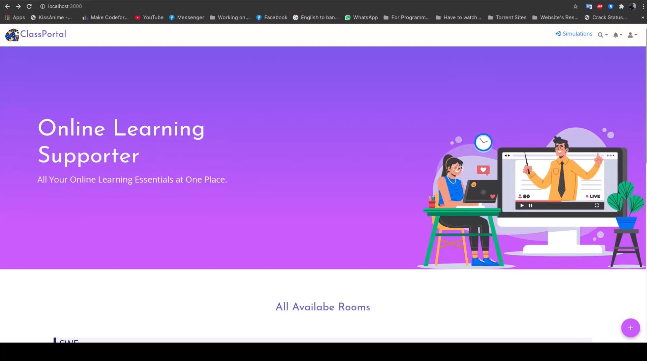
Sneak Peak into Our Website!

Slide 13
SUST__NOOBs
Shahriar Elahi Dhruvo
Mahfuzur Rahman Emon
Sania Rahman
Mohammad Akhlaqur Rahman

Slide 14
Thanks!
And That was All!

